Slide 2
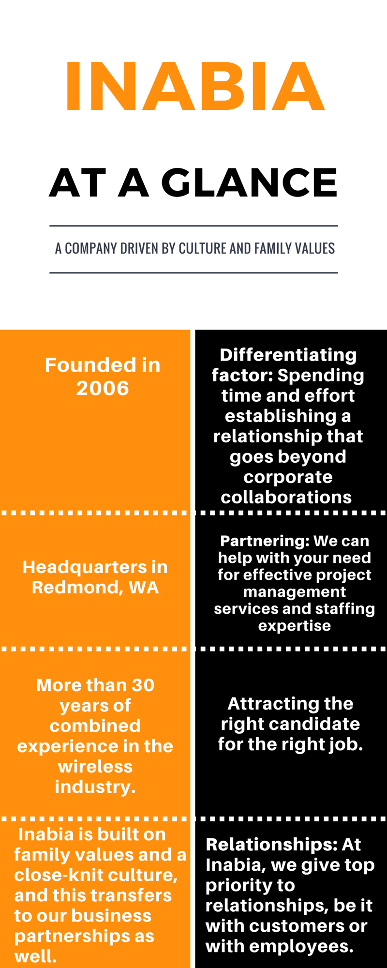

Slide 4
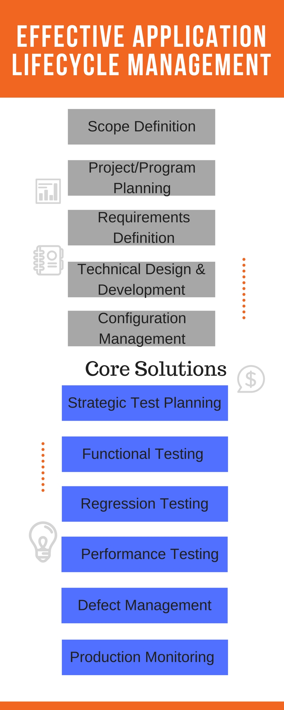
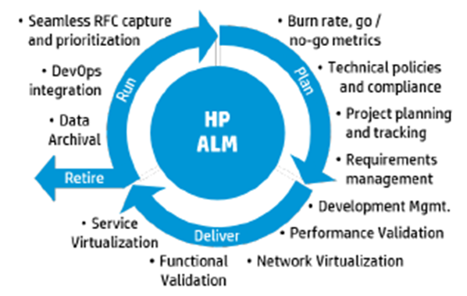

Slide 8
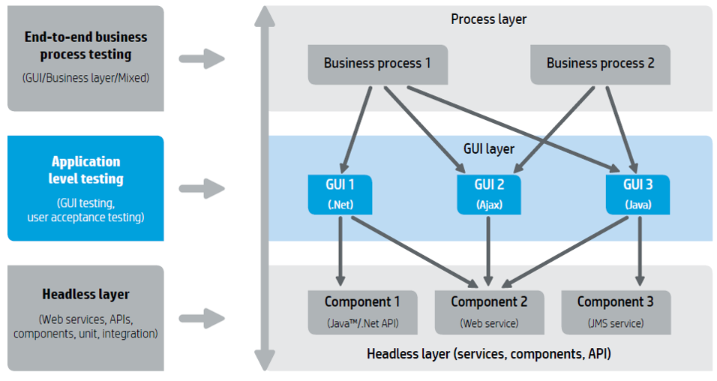

Slide 13
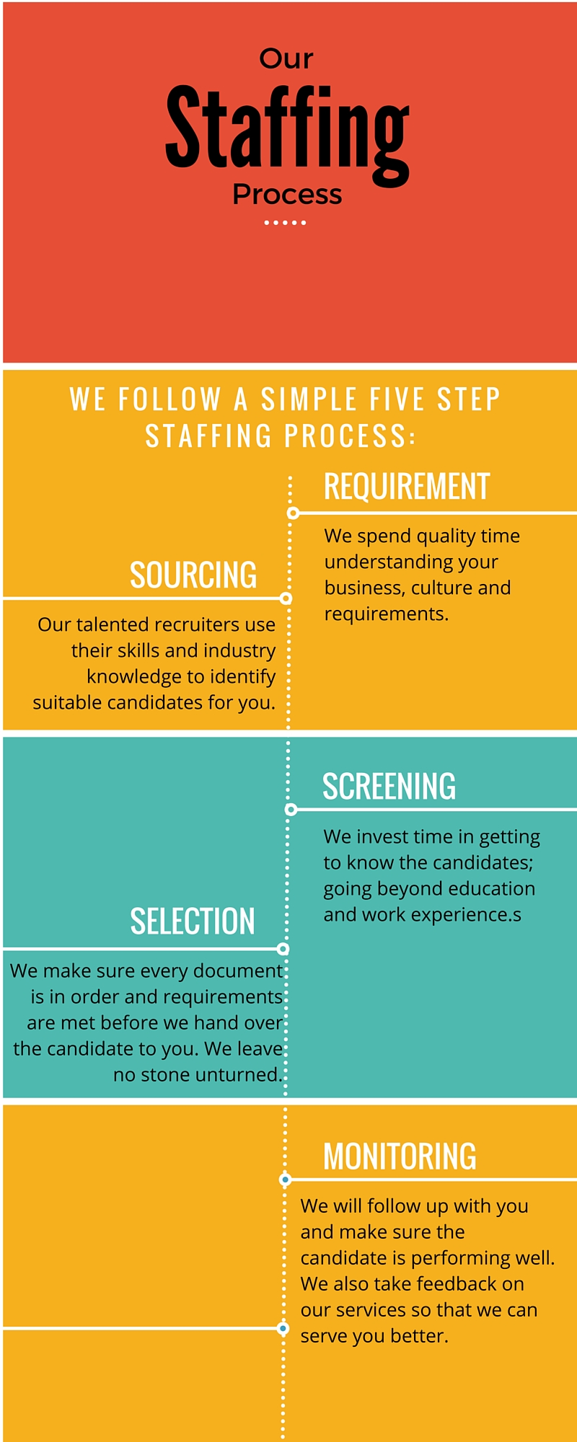
Our Staffing Capabilities:
A team of expert recruiters Personal referrals and candidates on bench.
Access to a variety of job portals and social media for sourcing.
A very aggressive pre-screening process.
Create and assist in all necessary client paperwork

